Slide 1
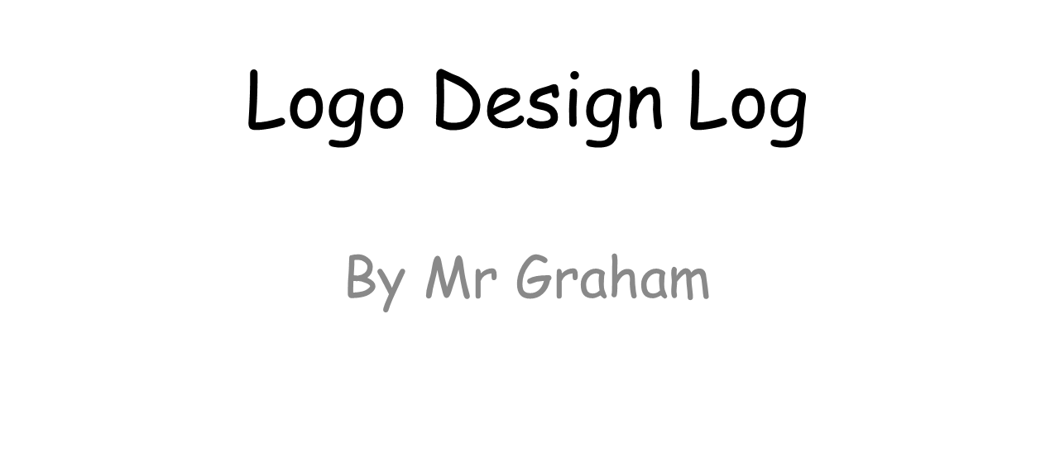

Slide 2
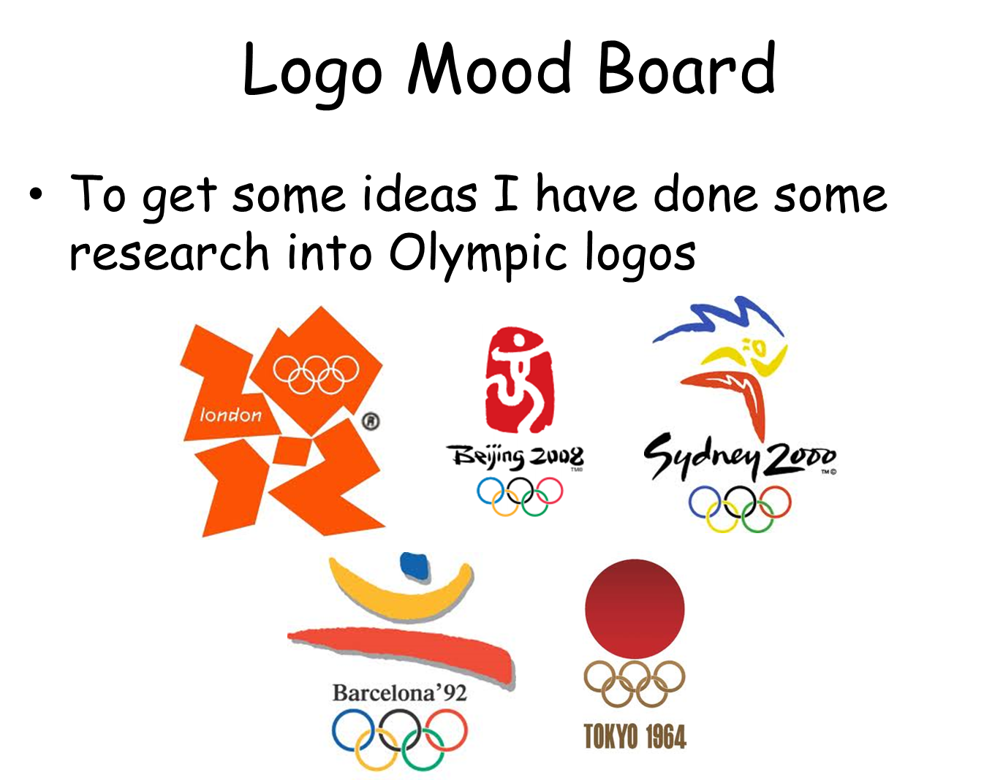

Slide 3
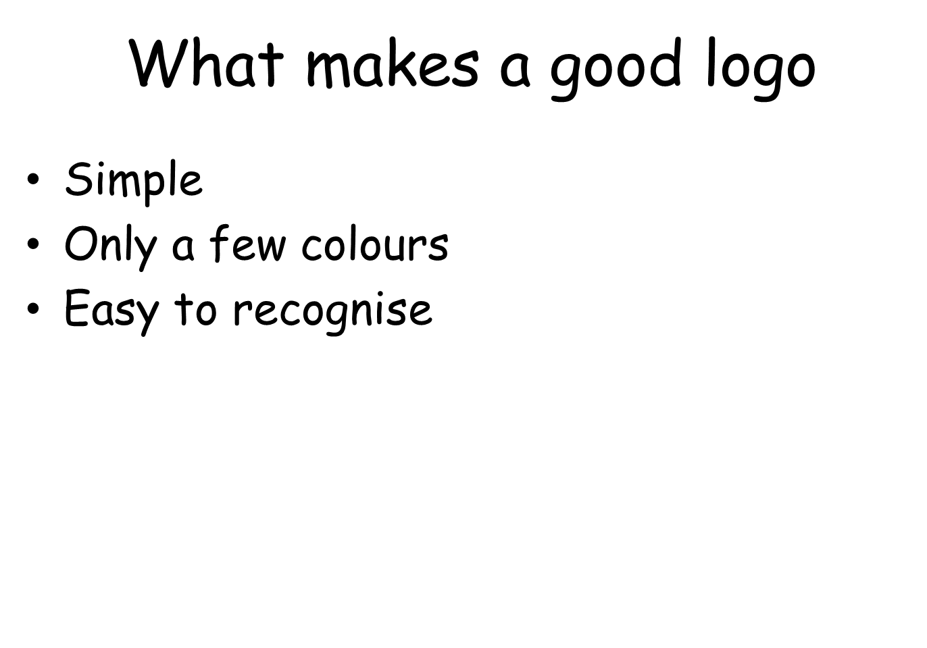

Slide 4
Logo Design Brief
be created using only vector tools
use at least three colours
also work in a single colour
work in different sizes and on different materials

Slide 5
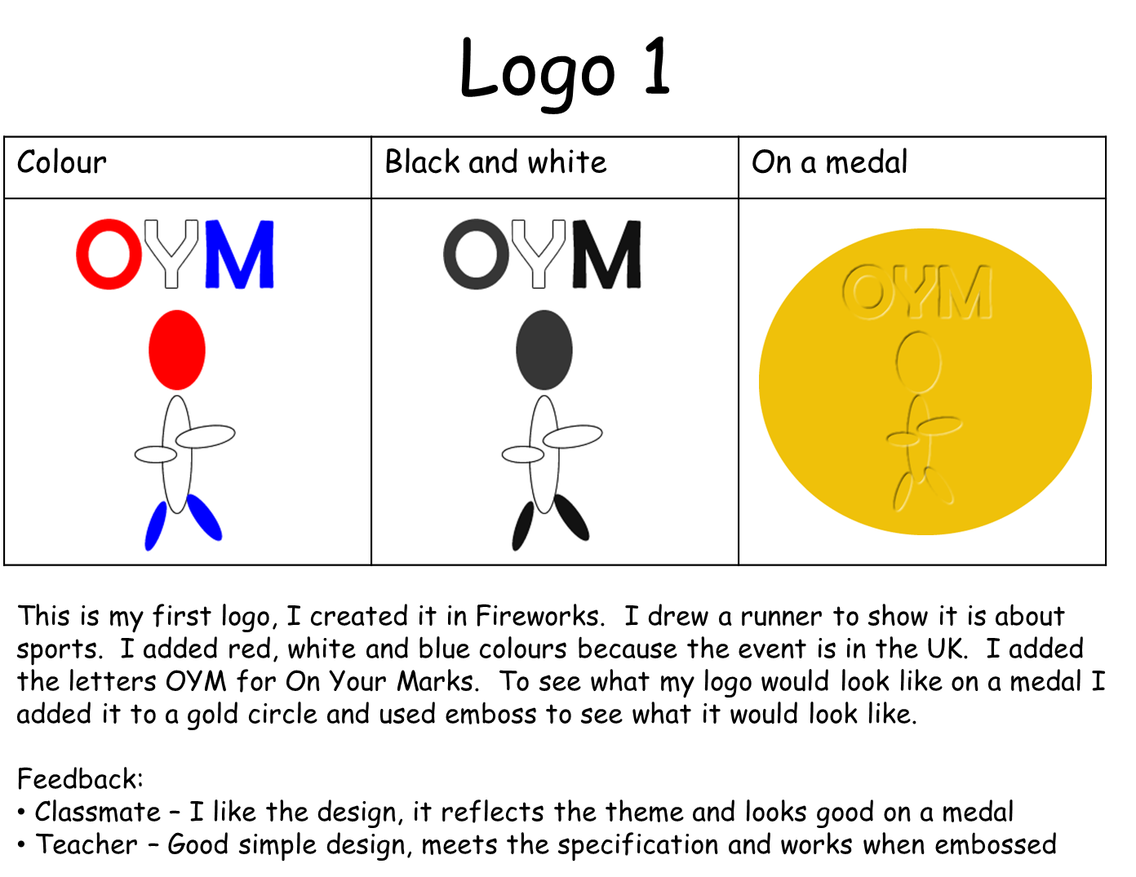

Slide 6
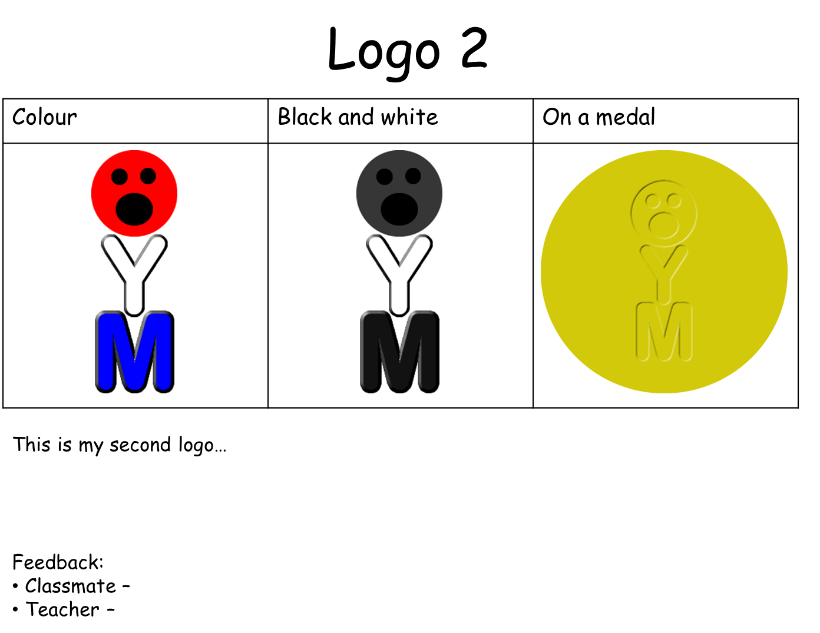

Slide 7
